Slide 1
STEP 8 – TESTING & RELEASE
The really exciting bits…

Slide 2
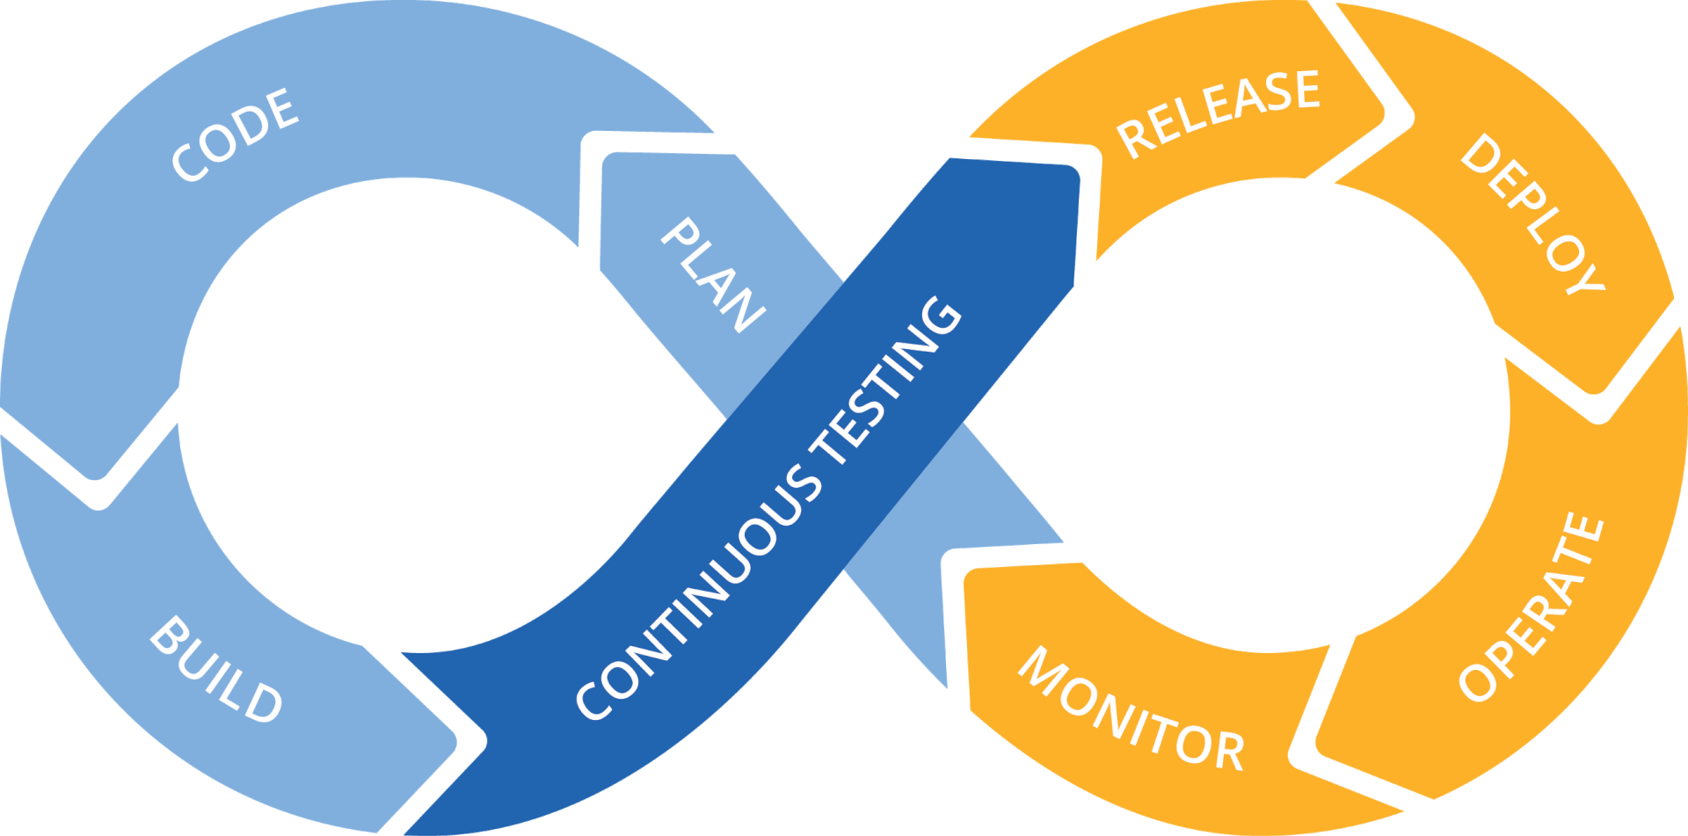
Step 8 Test & Release App Cycle
Why is testing important? Users are a pain in the backside!
They break what’s there
They ask for what’s not there
They use what’s there for something completely different
They complain about things you never knew existed until they complained

Slide 3
Step 8 Test & Release App Cycle
When it comes to release time you have a few options:
Cloud release (such as Azure, Amazon Web Services etc.)
Web hosting this can be free or paid and offers a whole variety of options to fit most projects and budgets
Host from home anyone can do this with the right settings on their router, a spare computer and will work better with a static IP address from your internet provider

